Slide 1
12/4/2024
PRODUCT OVERVIEW
Employee
Management System Steven Zhang - IS 410 Semester Project Fall 2024

Slide 2
Business Document
Situation
Project Schedule
This employee management system is designed to assist managers or supervisors to keep track of a large number of employee information.
This system allows for inserting, deleting, and updating employee data. Furthermore, this system’s users can develop queries that allow them find and display the specific employee information they are looking for.
In particular, this database stores information such as employee ID, names, DOB, department, and other information about the employees.
Since this database is more generalized (e.g. department names), it can be adjusted to fit specific business needs.
First Week: Problem Analysis and Planning.
Analyzing the business problem and developing a timeline for the project.
Creating an EER diagram that outlines the entities, attributes, and relationships to be included in the database
Create a relational SQL schema that translates the EER diagram into a more SQL friendly format.
Second Week: Developing the SQL Database
Create tables and queries.
Third Week: Testing and Finalizing
Test queries and finalize the presentation.
*The presentation is updated throughout the project timeline to ensure it is completed efficiently*

Slide 3
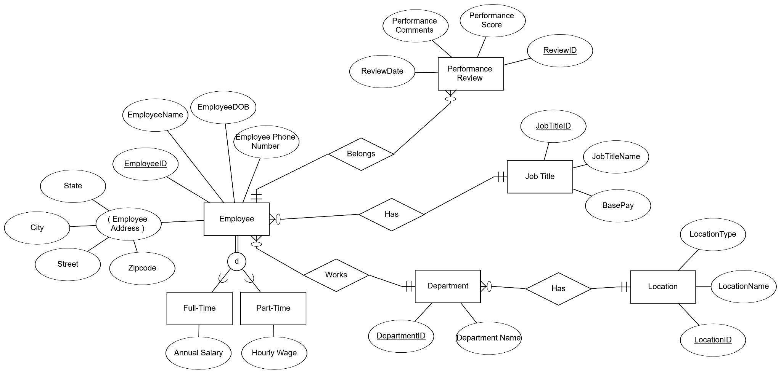
EER Diagram

Slide 4
Relational Schema
JOB_TITLE(JobTitleID, JobTitleName, BasePay)
LOCATION(LocationID, LocationName, LocationType)
DEPARTMENT(DepartmentID, Department_Name, LocationID)
EMPLOYEE(EmployeeID, EmployeeName, EmployeeDOB, Employee_Phone_Number, Street, City, State, Zipcode, DepartmentID, JobTitleID)
FULL_TIME(FTEmployeeID, Annual_Salary)
PART_TIME(PTEmployeeID, Hourly_Wage)
PERFORMANCE_REVIEW(ReviewID, Performance_Score, Performance_Comments, ReviewDate, EmployeeID)

Slide 5
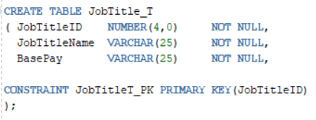
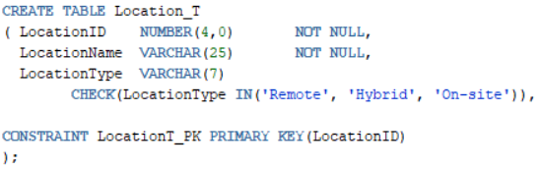
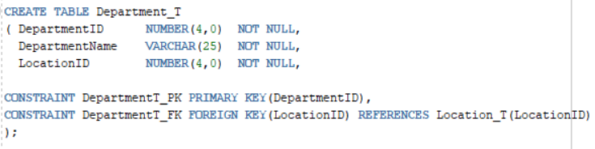
Creation of Tables
JobTitle_T
Location_T
Department_T

Slide 6
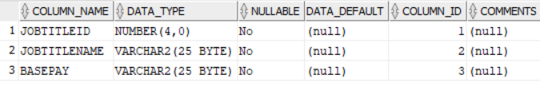
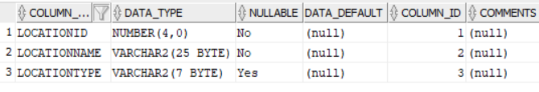
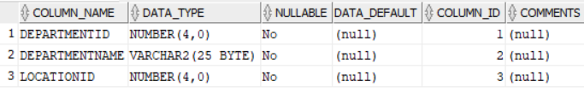
Creation of Tables
JobTitle_T
Location_T
Department_T

Slide 7
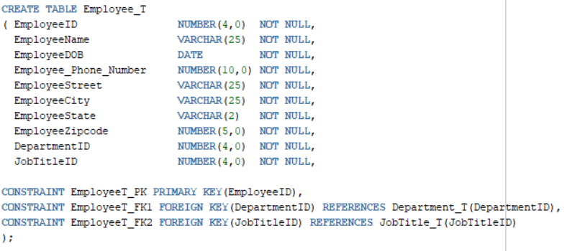
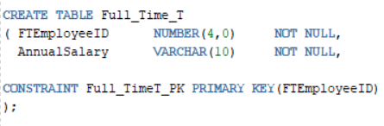
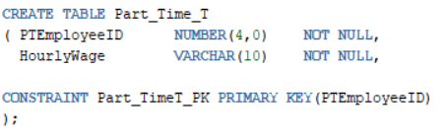
Creation of Tables
Employee_T
Full_Time_T
Part_Time_T

Slide 8
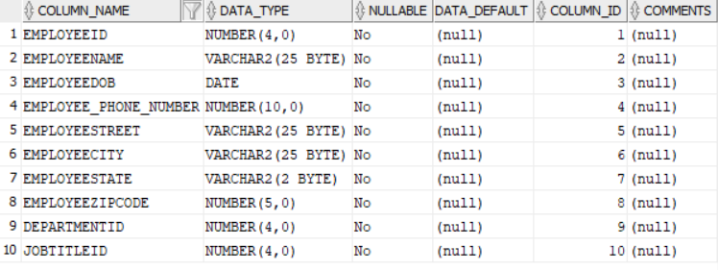
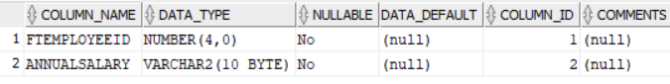
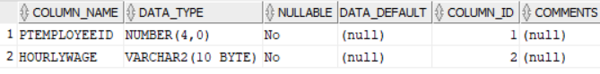
Creation of Tables
Employee_T
Full_Time_T
Part_Time_T

Slide 9
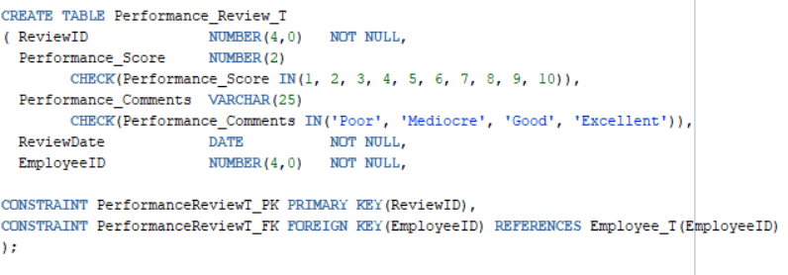
Creation of Tables
Performance_Review_T

Slide 10
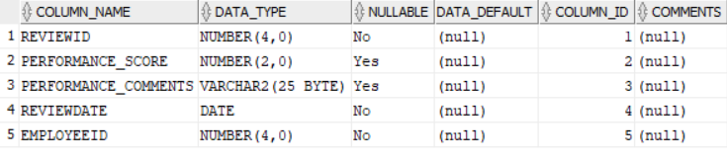
Creation of Tables
Performance_Review_T

Slide 11
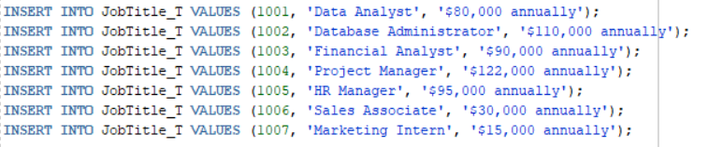
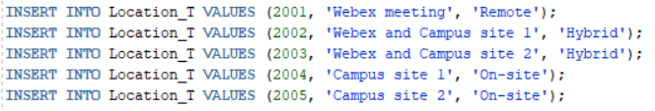
Input of Table Data
JobTitle_T Data
Location_T Data

Slide 12
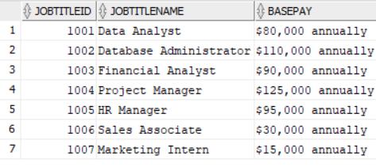
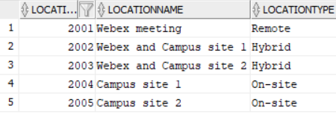
Input of Table Data
JobTitle_T Data
Location_T Data

Slide 13
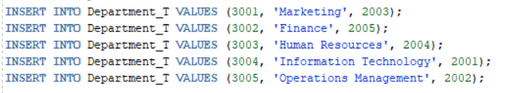
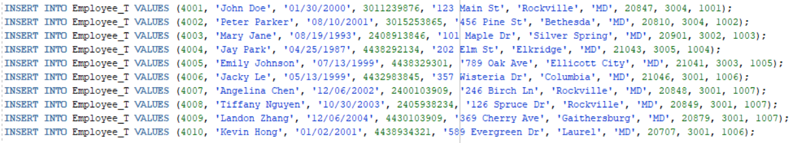
Input of Table Data
Department_T Data
Employee_T Data

Slide 14
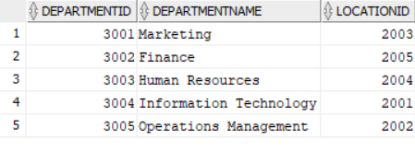
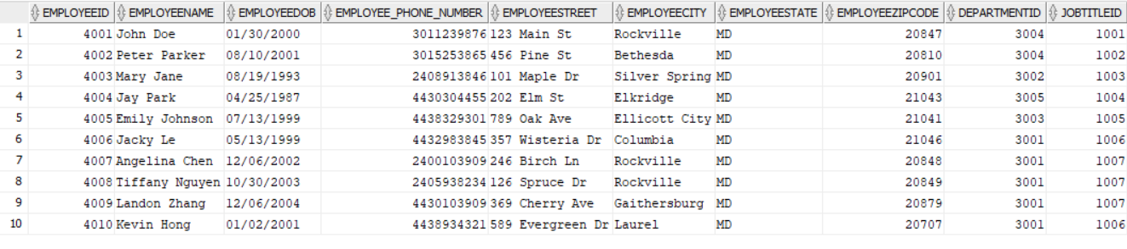
Input of Table Data
Department_T Data
Employee_T Data

Slide 15
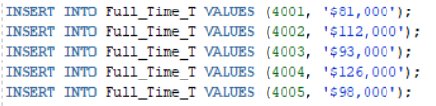
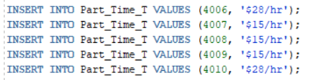
Input of Table Data
Full_Time_T Data
Part_Time_T Data

Slide 16
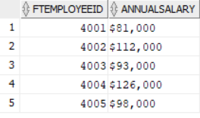
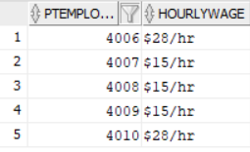
Input of Table Data
Full_Time_T Data
Part_Time_T Data

Slide 17
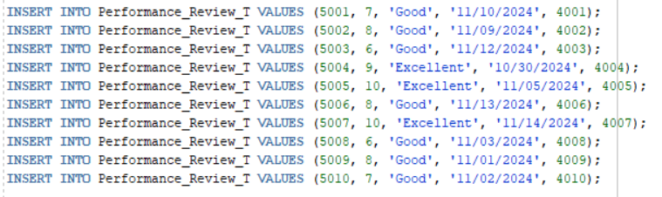
Input of Table Data
Performance_Review_T Data

Slide 18
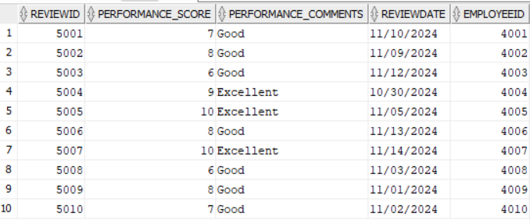
Input of Table Data
Performance_Review_T Data

Slide 19
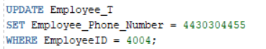
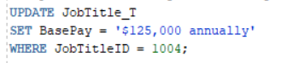
Update Statements
Update Jay Park's phone number from 4438292134 to 4430304455
Update the Base Pay for the Project Manager job title from $122,000 annually to $125,000 annually.

Slide 20
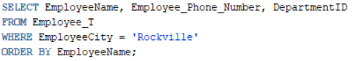
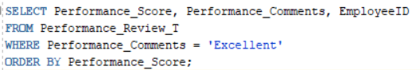
Select Statements
Create a query that displays the Employee Name, Employee Phone Number, and DepartmentID for all employees who live in Rockville, ordered by EmployeeName
Create a query that displays the Performance Score, Performance Comments, and Employee ID for all Performance Reviews that are excellent, ordered by the Performance Score

Slide 21
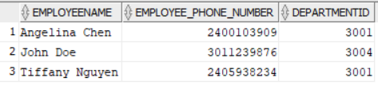
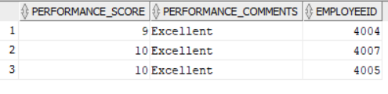
Select Statements (Outputs)
Create a query that displays the Employee Name, Employee Phone Number, and DepartmentID for all employees who live in Rockville, ordered by EmployeeName.
Create a query that displays the Performance Score, Performance Comments, and Employee ID for all Performance Reviews that are excellent, ordered by the Performance Score.

Slide 22
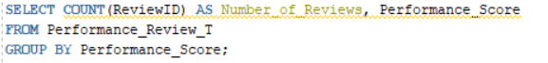
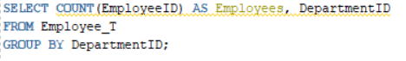
Queries with Group By Statements
Create a query that displays the count of ReviewIDs as Number_of_Reviews that received each Performance Score, grouped by Performance Score.
Create a query that displays the count of EmployeeIDs as Employees who work in each Department identified by its DepartmentID, grouped by DepartmentID.

Slide 23
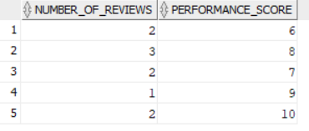
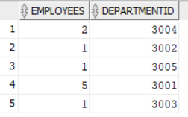
Queries with Group By Statements (Outputs)
Create a query that displays the count of ReviewIDs as Number_of_Reviews that received each Performance Score, grouped by Performance Score.
Create a query that displays the count of EmployeeIDs as Employees who work in each Department identified by its DepartmentID, grouped by DepartmentID.

Slide 24
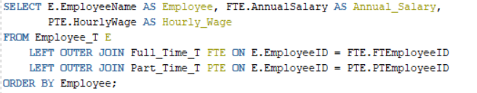
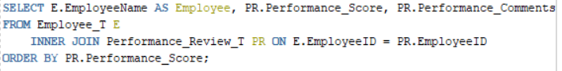
Join Queries (1 / 2)
Create a query that displays every employee name and the annual salary if they are full time employees or the hourly wage if they are part time employees, ordered by employee.
2. Create a query that displays the employee name, performance score, and performance
comments for all reviews, ordered by performance score.

Slide 25
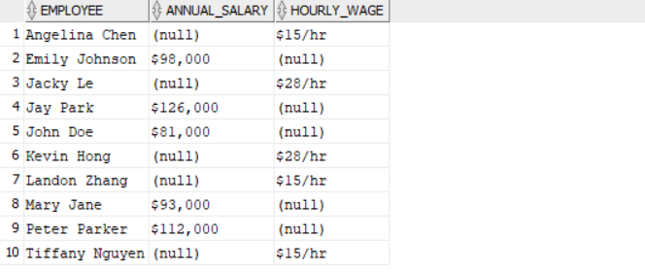
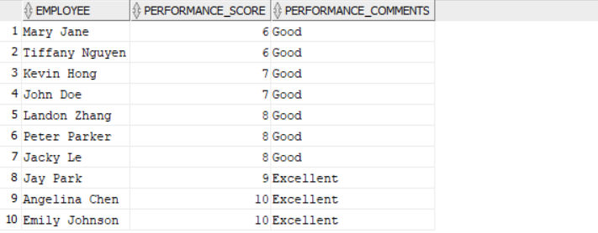
Join Queries (1 / 2) Outputs
Create a query that displays every employee name and the annual salary if they are full time employees or the hourly wage if they are part time employees, ordered by employee.
Create a query that displays the employee name, performance score, and performance comments for all reviews, ordered by performance score.

Slide 26
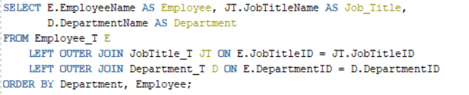
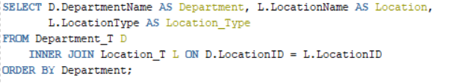
Join Queries (2 / 2)
3. Create a query that displays each employee's name, their job title, and the
department they are in, ordered by department, then by employee.
4. Create a query that displays all department names, their location name, and its
location type, ordered by department.

Slide 27
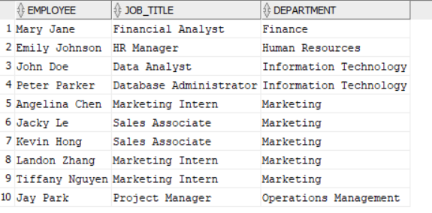
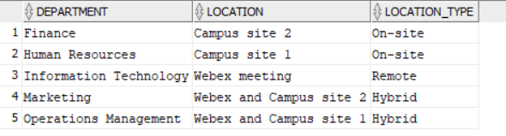
Join Queries (2 / 2) Outputs
3. Create a query that displays each
employee's name, their job title, and
the department they are in, ordered by
department, then by employee.
4. Create a query that displays all
department names, their location
name, and its location type, ordered
by department.

Slide 28
Thank you.

